Slide 1
BIOLOGY FOR ENGINEERS
MODULE -I
INTRODUCTION TO BIOLOGY: The cell: the basic unit of life, Structure, and functions of a cell. The Plant Cell and animal cell, Prokaryotic and Eukaryotic cells, Stem cells and their application. Biomolecules: Properties and functions of Carbohydrates, Nucleic acids, proteins, lipids. Importance of special biomolecules; Enzymes (Classification with one example each), Properties and functions), vitamins, and hormones.
THE CELL
The cell is the basic unit of Life. The cell provides minimum requirements to perform essential life properties such as organization, metabolism, responsiveness, movements, and reproduction to live independently. Hence, it ensures 1. Independent existence
2. Performing the vital functions of life.
Robert Hooke discovered the cell in 1665, later Anton Van Leeuwenhoek discovered free living algae Spirogyra cells in water in the pond in 1674. Robert Brown later discovered the nucleus.
Cells are built from Biomolecules such as carbohydrates, Lipids, Proteins, and Nucleic acids. They exhibit variations in their size (In the Human body, the Largest cell is the ovum and the smallest cell is the sperm), shape (round, spherical or elongated), life span (white blood cells only live for about 13 days, whereas red blood cells live for about 120 days) and function (Organ specific). Cells that have a similar structure and function form tissues. A cell can form a whole organism as in unicellular like bacteria, or it may be part of the multicellular like Humans.

Slide 2
STRUCTURE AND FUNCTIONS OF A CELL
Understanding cell structure and functions is key to understanding life processes. Structure:
1.Plasma Membrane: Surrounds the cell, regulating the passage of substances.
2.Cytoplasm: Jelly-like substance filling the cell, containing organelles.
3.Nucleus: Houses genetic material (DNA), controlling cell activities. For preliminary reference
4. Organelles: Specialized structures:
a. Endoplasmic Reticulum: Involved in protein and lipid metabolism.
b. Golgi Apparatus: Modifies, sorts, and packages molecules.
c. Mitochondria: Generates energy through respiration.
d. Lysosomes: Break down waste materials.
e. Ribosomes: Sites of protein synthesis.
f. Centrioles (in animals): Assist in cell division.
g.Cytoskeleton: Provides structural support and aids in cell movement.

Slide 3
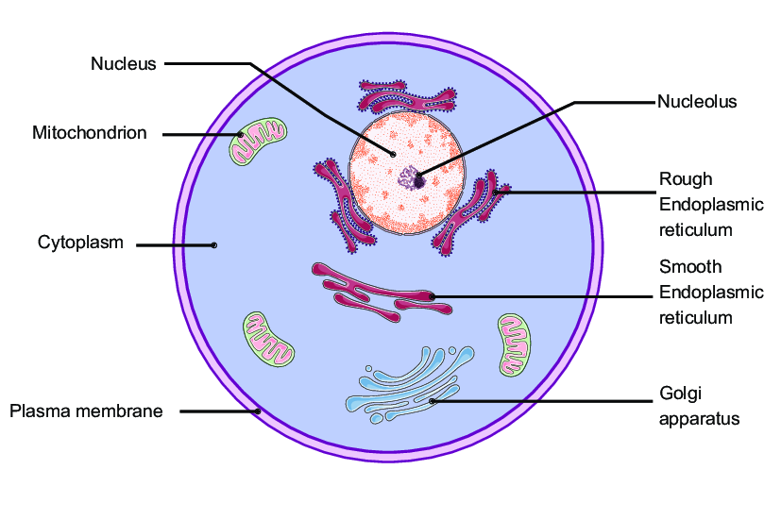
Structure of the Cell

Slide 4
Functions:
1. Respiration: Converts glucose into ATP for energy.
2. Protein Synthesis: Translates genetic information into proteins.
3. Storage and Processing: Synthesizes, modifies, and transports molecules.
4. Cellular Communication: Signals between cells via various molecules.
5. Waste Management: Breaks down and recycles cellular waste.
6. Cell Division: Replicates cells for growth, repair, and reproduction

Slide 5
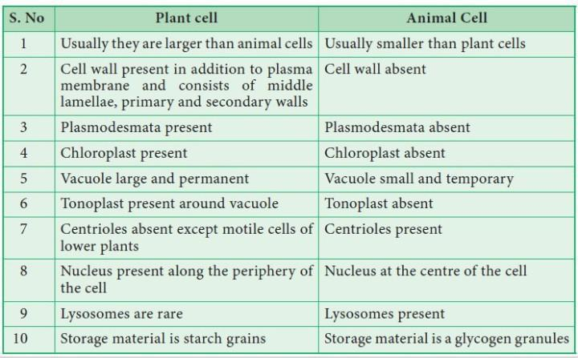

Slide 6
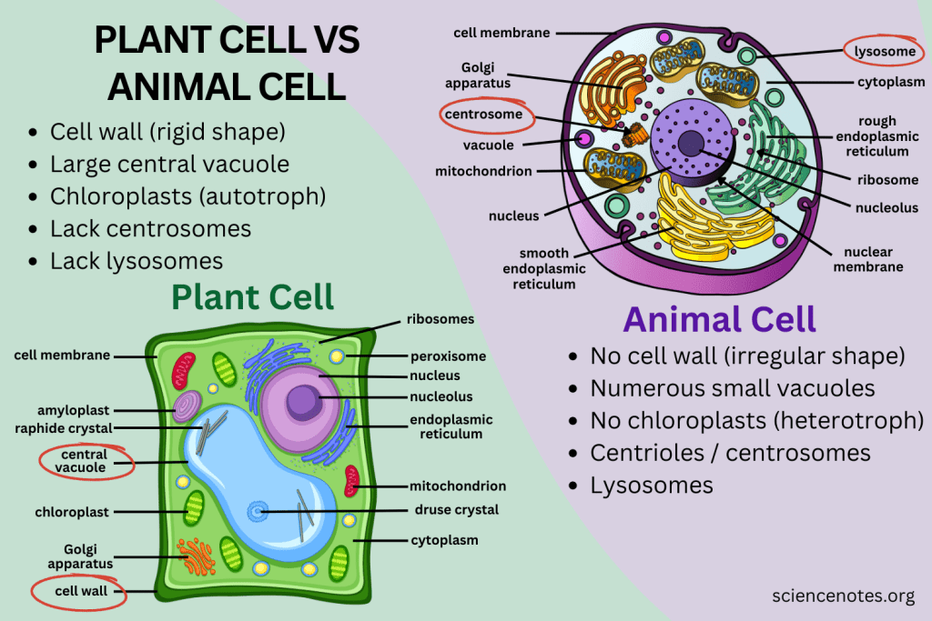

Slide 7
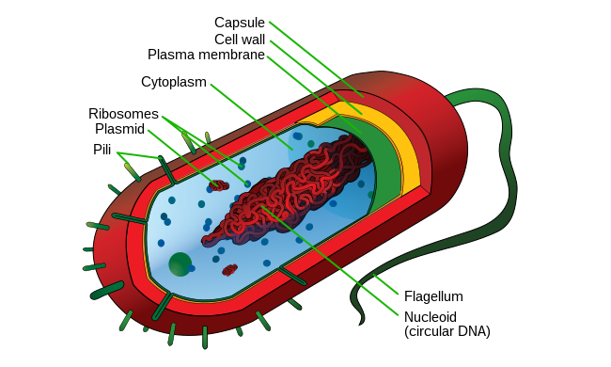
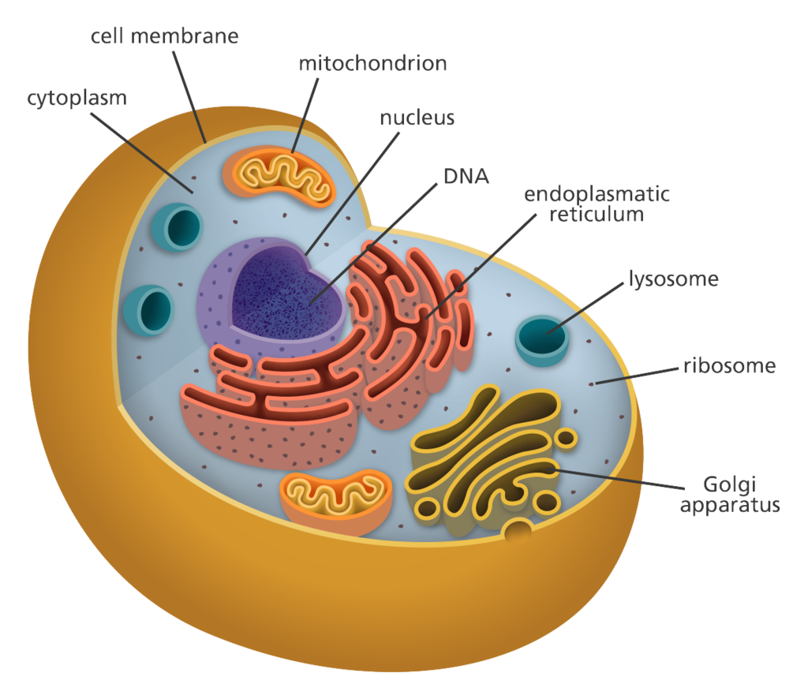
Prokaryotic and Eukaryotic cell
In Prokaryotic cell lack of nucleus instead of nucleus nucleoid is present.
In Eukaryotic cell well developed nucleus and nuclear membrane is present.

Slide 8
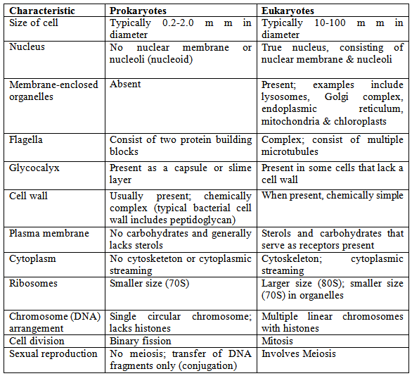

Slide 9
Stem Cells and their Application
Introduction
Stem cells are unique cells with the remarkable ability to develop into various specialized cell types in the body.
They play a crucial role in growth, tissue repair, and maintaining the body's overall health.
Types of Stem Cells
1. Embryonic Stem Cells: Derived from embryos, these cells have the potential to become any cell type in the body.
Adult or Somatic Stem Cells: Found in various tissues, they specialize in generating cells specific to their tissue of origin.
They possess two main characteristics
1.Self-Renewal: The ability to divide and produce more stem cells, maintaining a renewable source for further differentiation.
2.Differentation: The potential to differentiate into various cell types depending on their environment and the signals they receive.

Slide 10
Applications
1. Regenerative Medicine
Tissue Repair: Stem cells are used to regenerate damaged or diseased tissues, aiding in organ repair.
Orthopedic Treatments: Applied in bone and joint disorders for enhanced healing.
2. Treatment of Diseases
Blood Disorders: Stem cells are used in treating conditions like leukemia and anemia.
Neurological Disorders: Research explores their potential for treating conditions like Parkinson's and Alzheimer's.
3. Drug Development and Testing
Stem cells serve as a valuable model for testing new drugs, predicting their effects on human cells.
4. Understanding Disease Mechanisms
Studying stem cells provides insights into the development and progression of diseases.
5. Cell-Based Therapies
Stem cells offer a foundation for developing cell-based therapies, addressing various medical conditions.

Slide 11
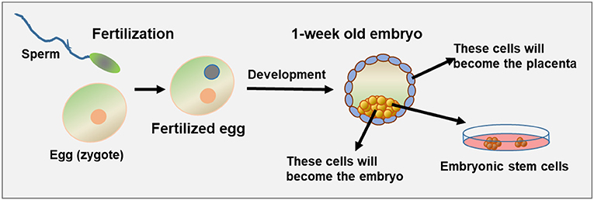
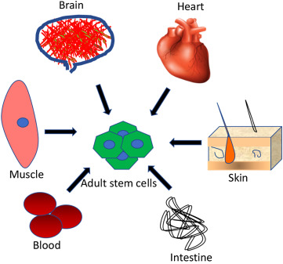
6.Personalized Medicine
Tailoring treatments based on an individual's genetic makeup, utilizing stem cells for personalized therapies.
Embryonic stem cells Adult stem cells

Slide 12
Introduction and Importance of Biomolecules
Introduction to Biomolecules:
Biomolecules are essential molecules that make up the building blocks of life.
These diverse compounds play crucial roles in the structure and functioning of living organisms.
Among the key biomolecules are carbohydrates, nucleic acids, proteins, and lipids, each contributing uniquely to the intricate tapestry of life.
Importance of Biomolecules:
Carbohydrates: They play a vital role in fueling various cellular processes, supporting growth, and facilitating quick energy release.
2. Nucleic Acids: They are fundamental for inheritance, genetic diversity, and the synthesis of proteins essential for life processes.
3. Proteins: They contribute to the regulation of biological processes, cellular structure, and the catalysis of biochemical reactions.
4. Lipids: They are crucial for maintaining cell integrity, providing a protective barrier, and serving as reserve energy sources.

Slide 13
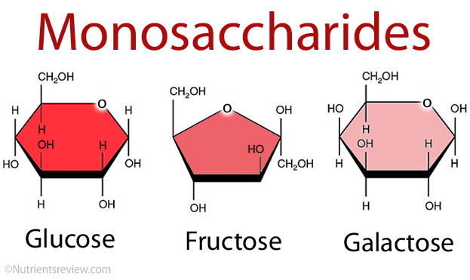
Carbohydrates
Carbohydrates are a class of organic compounds that play a crucial role in biology and are an important source of energy for living organisms. They are composed of carbon (C), hydrogen (H), and oxygen (O) atoms and are classified based on their molecular structure and function. General formula is Cn(H2O)n.
Monosaccharides
These are the simplest form of carbohydrates and include glucose and fructose. They are easily soluble in water and serve as the primary source of energy for the body.

Slide 14
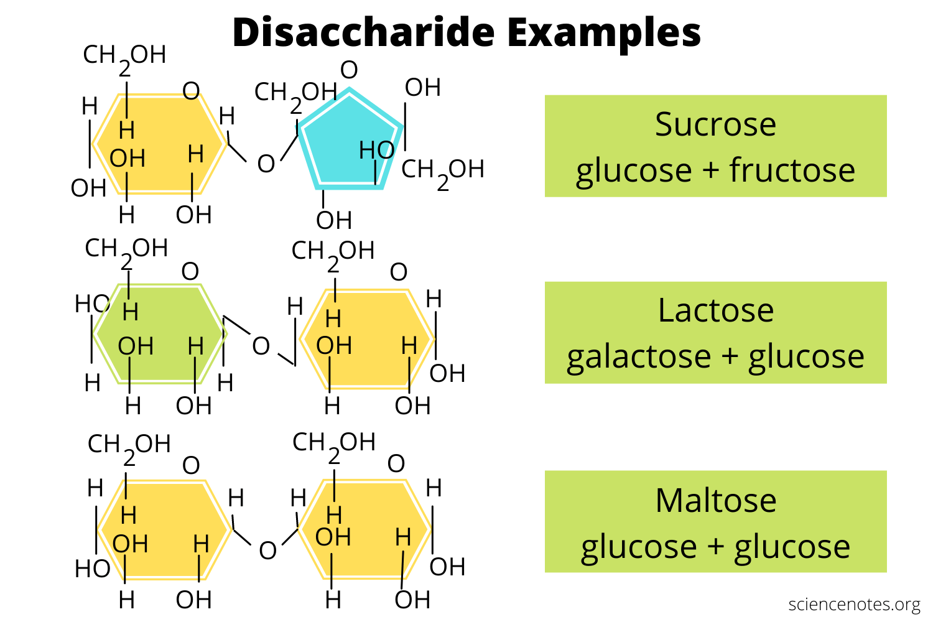
Disaccharides
These are formed by the condensation of two monosaccharides and include sucrose, lactose, and maltose. They are commonly found in sugar and are broken down into monosaccharides during digestion.

Slide 15
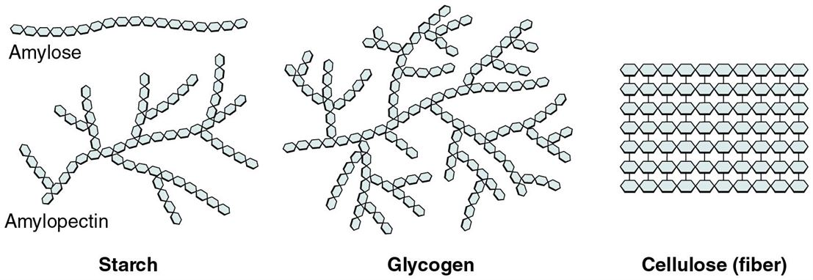
Polysaccharides
These are long chains of monosaccharides linked together. They serve as storage molecules for energy, such as glycogen in animals and starch in plants, and also provide structure and support, such as cellulose in plant cell walls. In addition to their role as energy sources, carbohydrates also play important roles in cellular processes, such as cellular signaling and recognition, and in regulating gene expression.

Slide 16
Industrial Applications of Carbohydrates
Carbohydrates have a wide range of applications in various industries, including:
Food and Beverage: Carbohydrates are widely used as sweeteners, thickeners, and stabilizers in food and beverage products. They are also used as energy sources in sports drinks and energy bars.
Pharmaceuticals: Carbohydrates are used as excipients in pharmaceutical formulations to improve the stability, solubility, and bioavailability of drugs. They are also used as a source of energy in medical nutrition products.
Cosmetics: Carbohydrates are used in cosmetic products, such as moisturizers, shampoos, and conditioners, to provide hydration and improve skin and hair health.
Biotechnology: Carbohydrates are widely used in the production of biodegradable plastics, biofuels, and other renewable energy sources.
Research: Carbohydrates are widely used as research tools in the fields of immunology, virology, and cellular biology. They are used as ligands in protein-carbohydrate interactions and as probes to study cellular signaling pathways.

Slide 17
Nucleic Acids
Nucleic acids are biopolymers that play a crucial role in the storage and transfer of genetic information in all living organisms.
There are two types of nucleic acids:
Deoxyribonucleic acid (DNA): DNA is the genetic material that carries the instructions for the development, functioning, and reproduction of all living organisms. DNA is a double-stranded helix structure composed of(deoxyribose), a phosphate group, and a nitrogenous base (adenine, guanine, cytosine, or thymine).
Ribonucleic acid (RNA): RNA is involved in the expression of the genetic information stored in DNA by carrying the message from the DNA to the ribosome, where it is used to build proteins. RNA is a single-stranded molecule composed of nucleotides, which consist of a sugar (ribose), a phosphate group, and a nitrogenous base (adenine, guanine, cytosine, or uracil).

Slide 18
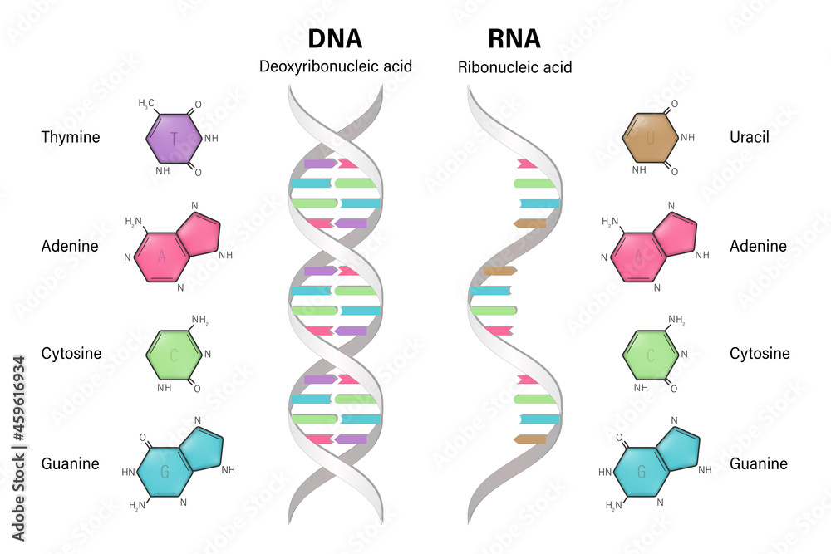
Both DNA and RNA play essential roles in the functioning of cells and organisms, and their structures and interactions with other molecules are the basis for many biological processes such as replication, transcription, and translation.

Slide 19
Proteins
Proteins are large, complex molecules made up of chains of smaller building blocks called amino acids. They play a vital role in the structure, function, and regulation of cells, tissues, and organs.
There are 20 standard amino acids that serve as the building blocks of proteins. Essential Amino Acids (9):
1. Histidine
2. Isoleucine
3. Leucine
4. Lysine
5. Methionine
6. Phenylalanine
7. Threonine
8. Tryptophan
9. Valine

Slide 20
Non-Essential Amino Acids (11):
1. Alanine
2. Arginine
3. Asparagine
4. Aspartic Acid
5. Cysteine
6. Glutamic Acid
7. Glutamine
8. Glycine
9. Proline
10. Serine
11. Tyrosine
Essential amino acids cannot be synthesized by the body and must be obtained through the diet, while non-essential amino acids can be synthesized by the body.

Slide 21
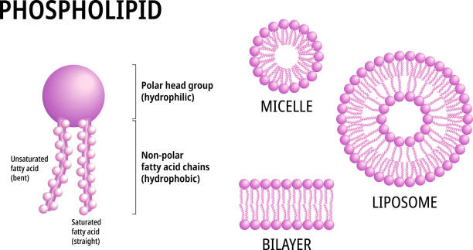
Lipids
Lipids are a group of organic compounds that include fats, oils, waxes, and some hormones.
Schematic representation of lipid molecule, bilayer formation, and miscelle formation.

Slide 22
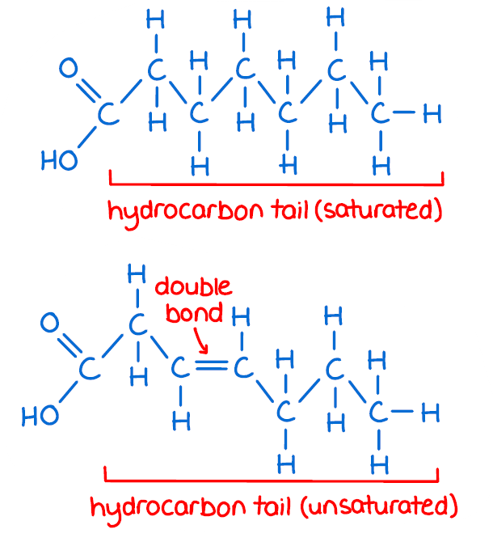

Slide 23
Properties and Functions of Carbohydrates
Properties
1.Chemical Composition:
Composition: Carbohydrates are organic compounds composed of carbon, hydrogen, and oxygen in a ratio of 1:2:1.
Monomers: The basic building blocks of carbohydrates are monosaccharides, such as glucose and fructose.
2. Solubility:
Water Solubility: Most carbohydrates are soluble in water due to their hydrophilic nature.
3. Classification:
Simple and Complex: Carbohydrates are classified into simple sugars (monosaccharides and disaccharides) and complex carbohydrates (polysaccharides).

Slide 24
Functions
1. Energy Source:
Primary Role: Carbohydrates serve as a primary source of energy for living organisms.
Conversion: Monosaccharides are converted into ATP, the energy currency of cells.
2. Energy Storage:
Glycogen (in Animals): Excess glucose is stored in the form of glycogen in animals, primarily in the liver and muscles.
Starch (in Plants): Plants store surplus glucose as starch in various plant tissues.
3. Structural Support:
Cellulose (in Plants): Carbohydrates contribute to the structural support of plant cell walls through the formation of cellulose.
4. Transport of Energy:
Sucrose: Carbohydrates like sucrose facilitate the transport of energy in the form of sugars within plants.
5. Quick Energy Release:
Glucose: Rapid breakdown of glucose provides quick energy for cellular processes.

Slide 25
6. Metabolic Regulation:
Blood Sugar Regulation: Carbohydrates play a role in regulating blood sugar levels, ensuring a steady energy supply.
Properties and Functions of Nucleic Acids
Understanding the properties and functions of nucleic acids is fundamental to comprehending the mechanisms of heredity, genetic disorders, and cellular processes.
Properties of Nucleic Acids
Polymer Structure: Nucleic acids are polymers composed of nucleotide monomers linked together.
2. Nucleotide Composition: Each nucleotide consists of a sugar molecule, a phosphate group, and a nitrogenous base.
3. Sequence Specificity: The sequence of nitrogenous bases along the nucleic acid chain is specific and carries genetic information.

Slide 26
4.Double Helix (DNA):
DNA has a double-helix structure, where two strands wind around each other.
5. Single-Stranded (RNA):
RNA is usually single-stranded, with various types like mRNA, tRNA, and rRNA.
6. Genetic Code:
Nucleic acids encode the genetic information that determines the traits and characteristics of living organisms.
7. Complementary Base Pairing:
In DNA, adenine pairs with thymine, and guanine pairs with cytosine, forming complementary base pairs.
8. Role in Protein Synthesis:
Nucleic acids facilitate protein synthesis by carrying and translating genetic instructions.

Slide 27
9. Essential for Heredity:
Nucleic acids are vital for the inheritance of genetic traits from one generation to the next.
10. Cellular Regulation:
They participate in regulating cellular processes, gene expression, and various metabolic activities.
Functions of Nucleic Acids
Genetic Information Storage: Nucleic acids, particularly DNA, store and carry genetic information that dictates the hereditary characteristics of living organisms.
2. Protein Synthesis: Nucleic acids, through the process of transcription and translation, play a crucial role in the synthesis of proteins, the building blocks of cells.
3. Cellular Regulation: They participate in the regulation of various cellular processes, controlling gene expression and influencing the overall functioning of cells

Slide 28
4.Hereditary Transmission:
Nucleic acids are responsible for transmitting hereditary traits from parents to offspring, ensuring the continuity of genetic information.
5. Transfer of Genetic Code:
RNA, a type of nucleic acid, carries the genetic code from DNA to the ribosomes, where protein synthesis occurs.
6. Enzymatic Activities:
Some nucleic acids, like ribozymes, exhibit enzymatic activities, participating in biochemical reactions within cells.
7. Energy Transfer:
Nucleic acids contribute to the transfer and storage of energy in the form of adenosine triphosphate (ATP), a molecule crucial for cellular energy currency.
8. Cellular Signaling:
Certain nucleic acids are involved in cellular signaling pathways, influencing responses to external stimuli and environmental changes.
9. Maintenance of Cell Structure:
Nucleic acids contribute to the maintenance and integrity of cell structures, influencing cell division and growth.
10. Synthesis of Biomolecules:
They are involved in the synthesis of various biomolecules, contributing to the overall structure and function of living organisms.

Slide 29
Properties and Functions of Proteins
Properties of Proteins
1. Structure:
Proteins exhibit a complex three-dimensional structure determined by their amino acid sequence.
They have primary, secondary (alpha helix, beta sheet), tertiary, and quaternary structural levels.
2. Amino Acid Composition:
Proteins are composed of amino acids linked by peptide bonds.
The specific arrangement of amino acids dictates the protein's structure and function.
3. Solubility:
Proteins can vary in solubility, with some being soluble in water (hydrophilic) and others in lipids (hydrophobic).
4. Denaturation:
Proteins can undergo denaturation due to factors like heat, pH changes, or chemicals, resulting in loss of structure and function.
5. Specificity:
Proteins exhibit specificity in their interactions, with each type designed for a particular function or molecular interaction.

Slide 30
6. Biological Functions:
Proteins serve diverse biological roles, including enzymes for catalysis, antibodies for immune response, and structural proteins for support.
7. Flexibility:
Proteins can change their conformation to adapt to different biological environments and perform their functions.
8. Binding and Recognition:
Proteins can bind to other molecules, facilitating cellular processes such as signaling and transport.
9. Catalytic Activity:
Many proteins act as enzymes, accelerating biochemical reactions within cells.
10. Diversity:
The diversity of proteins allows them to carry out a wide range of functions critical to cellular life.

Slide 31
Functions of Proteins with Examples
Enzymatic Activity:
Example: Catalase is an enzyme that catalyzes the breakdown of hydrogen peroxide into water and oxygen.
2. Structural Support:
Example: Collagen provides structural support to connective tissues in skin, bones, and tendons.
3. Transportation:
Example: Hemoglobin transports oxygen from the lungs to tissues and carries carbon dioxide back to the lungs.
4. Defense and Immunity:
Example: Antibodies defend against pathogens by recognizing and neutralizing foreign substances.
5. Cell Signaling:
Example: Insulin is a signaling protein that regulates glucose uptake by cells.
6. Motion and Contraction:
Example: Actin and myosin are proteins involved in muscle contraction and cell movement.

Slide 32
7. Hormonal Regulation:
Example: Insulin and glucagon are hormones that regulate blood sugar levels.
8. Storage of Molecules:
Example: Ferritin stores iron in a soluble and non-toxic form in cells.
9. Catalysis of Metabolic Reactions:
Example: Lipase is an enzyme that catalyzes the breakdown of lipids during digestion.
10. Regulation of Gene Expression:
Example: Transcription factors regulate the expression of genes during protein synthesis.
11. Sensory Response:
Example: Rhodopsin is a light-sensitive protein involved in vision.
12. Blood Clotting:
Example: Fibrinogen is a protein involved in the blood clotting cascade.
13. Buffering and pH Regulation:
Example: Hemoglobin helps maintain the pH balance in red blood cells.
14. Energy Source:
Example: In starvation, proteins can be broken down into amino acids for energy production.

Slide 33
Properties of Lipids
1.Hydrophobicity
Lipids are characterized by their hydrophobic nature, meaning they are insoluble in water but soluble in nonpolar solvents such as chloroform, ether, or benzene. This property arises from the nonpolar hydrocarbon chains of fatty acids and the hydrophobic regions of other lipid molecules, making them inherently repellant to water molecular.
2. Structural Diversity
Common lipid classes include fatty acids, triglycerides, phospholipids, sterols, and sphingolipids, each with unique molecular structures and properties that contribute to their biological functions.
3. Amphipathicity
Some lipids display amphipathic properties, containing both hydrophilic (water-attracting) and hydrophobic (water-repelling) regions within the same molecule. Phospholipids, for example, have hydrophilic phosphate heads and hydrophobic fatty acid tails, allowing them to form lipid bilayers in aqueous environments such as cell membranes.

Slide 34
4.Energy Storage
Triglycerides, the primary storage form of lipids, accumulate in adipose tissue and can be mobilized and oxidized to generate ATP, providing a long-term reservoir of energy for cellular metabolism and physical activity.
5.Insulation
Lipids act as insulators, helping to maintain body temperature and protect vital organs from temperature fluctuations and mechanical damage. Adipose tissue, composed primarily of fat cells, serves as an insulating layer beneath the skin, providing thermal insulation and cushioning for organs.
6.Lubrication
Lipid-based lubricants coat surfaces, preventing them from drying out and reducing wear and tear caused by friction between tissues, such as in joints or between skin surface.

Slide 35
Functions of Lipids
1.Energy Storage
Lipids serve as a concentrated energy reserve in the body, providing more than twice the energy per gram compared to carbohydrates or proteins. Triglycerides, the most common form of dietary fat, are stored in adipose tissue and can be mobilized and oxidized to generate ATP, the primary energy currency of cells.
2.Structural Role
Lipids contribute to the structural integrity of cell membranes, forming a lipid bilayer that encloses and protects the contents of cells. Phospholipids, cholesterol, and glycolipids are key components of cell membranes, regulating membrane fluidity, permeability, and signaling processes essential for cellular function and communication.
3.Hormone
Regulation Lipids play a crucial role in hormone synthesis and regulation, serving as precursors for steroid hormones such as estrogen, testosterone, and cortisol. These hormones regulate various physiological processes, including metabolism, growth, reproduction, and stress responses, exerting widespread effects on the body's functions.

Slide 36
4.Cell Signaling
Lipids function as signaling molecules in intercellular communication pathways, modulating cellular responses to environmental cues and stimuli. Lipid-derived signaling molecules, such as prostaglandins, leukotrienes, and sphingolipids, mediate inflammatory responses, immune function, and neuronal signaling, influencing diverse physiological processes.
5.Absorption of Nutrients
Lipids facilitate the absorption and transport of fat-soluble vitamins (A, D, E, and K) and other hydrophobic nutrients in the digestive system. Bile acids and lipases emulsify and break down dietary fats into absorbable forms, allowing for the For preliminary reference efficient uptake of essential nutrients across the intestinal epithelium and into the bloodstream.
6.Insulation
Lipids act as insulators, helping to maintain body temperature and protect vital organs from temperature fluctuations and mechanical damage. Adipose tissue, composed primarily of fat cells, serves as an insulating layer beneath the skin, providing thermal insulation and cushioning for organs.

Slide 37
ENZYMES
Enzymes are biological catalysts that accelerate biochemical reactions by lowering the activation energy required for the conversion of substrates into products. They are classified into six main classes based on the type of reaction they catalyze and the nature of their substrates.
Such as Oxidoreductases, Transferases, Hydrolases, Lyases , Isomerases , Ligases,
Classification of enzymes
Oxidoreductases- Oxidoreductases catalyze oxidation-reduction reactions, involving the transfer of electrons between substrates. These enzymes typically utilize cofactors such as NAD+ or FAD as electron carriers.
Transferases- Transferases facilitate the transfer of functional groups, such as methyl, acetyl, or phosphate groups, between substrates. These enzymes play essential roles in metabolic pathways and signal transduction.

Slide 38
Hydrolases
Hydrolases catalyze hydrolysis reactions, cleaving chemical bonds by adding water molecules. These enzymes are involved in the breakdown of macromolecules such as proteins, carbohydrates, and lipids.
Lyases
Lyases catalyze the addition or removal of groups to double bonds or the cleavage of bonds without hydrolysis or oxidation-reduction. These enzymes participate in diverse metabolic pathways and biosynthesis.
Isomerases
Isomerases catalyze the rearrangement of atoms within a molecule, resulting in the conversion between isomeric forms. These enzymes play crucial roles in maintaining metabolic equilibrium and generating biological diversity.
Ligases (Synthetases)
Ligases, also known as synthetases, catalyze the formation of bonds between molecules, often using energy from ATP hydrolysis. These enzymes are involved in DNA replication, RNA synthesis, and protein synthesis.

Slide 39
Properties of Enzymes
Specificity
Enzymes exhibit specificity in substrate recognition and catalytic activity, interacting with specific substrates to facilitate particular biochemical reactions. This specificity arises from the complementary shapes and chemical properties of the enzyme's active site and the substrate molecule.
Catalytic
Enzymes are catalysts that accelerate biochemical reactions by lowering the activation energy required for the conversion of substrates into products. By stabilizing the transition state of the reaction, enzymes facilitate the formation of product molecules more rapidly and efficiently.
Efficiency
Enzymes are highly efficient catalysts, often capable of increasing reaction rates by millions to billions of times compared to uncatalyzed reactions. This high efficiency allows cells to carry out metabolic processes at rates compatible with life despite relatively mild physiological conditions.
Regulation
Enzyme activity is regulated by various factors, including substrate concentration, pH, temperature, and the presence of inhibitors or activators. These regulatory mechanisms ensure that enzyme activity is finely tuned to meet the changing metabolic demand of the cell and maintain homeostatics.

Slide 40
Reusability
Enzymes are reusable catalysts that can catalyze multiple rounds of substrate the conversion without being consumed in the reaction. After facilitating a reaction, enzymes remain unchanged and available to catalyze subsequent reactions, making them highly economical and efficient components of cellular metabolism.
Sensitivity
Enzyme activity is sensitive to changes in environmental conditions, such as temperature and pH, which can influence enzyme structure and function. Small deviations from optimal conditions can significantly affect enzyme activity, leading to alterations in metabolic pathways and cellular function.

Slide 41
Functions of Enzymes
Catalysis
Enzymes serve as biological catalysts, accelerating chemical reactions by lowering the activation energy required for the conversion of substrates into products. By facilitating the formation of transition states and stabilizing reaction intermediates, enzymes enhance the rate of reactions without being consumed in the process.
Specificity
Enzymes exhibit high specificity for their substrates, recognizing and binding to specific molecules or chemical groups through complementary interactions at the enzyme's active site. This substrate specificity ensures that enzymes selectively catalyze particular reactions, leading to precise control over metabolic pathways and cellular processes.
Regulation
Enzyme activity is tightly regulated to maintain metabolic homeostasis and respond to changing environmental conditions. Regulation may occur through various mechanisms, including allosteric regulation, covalent modification, and feedback inhibition, which modulate enzyme activity in response to signals such as cellular energy level and hormonal signals.

Slide 42
Metabolic Pathways
Enzymes participate in metabolic pathways, sequences of interconnected biochemical reactions that convert substrates into products. Within these pathways, enzymes catalyze specific steps, regulating the flow of metabolites and ensuring the coordinated synthesis, degradation, and interconversion of biomolecules essential for cellular function and survival.
Signal Transduction
Enzymes play key roles in signal transduction pathways, transmitting extracellular signals into intracellular responses that regulate various cellular processes. For example, protein kinases and phosphatases catalyze the phosphorylation and dephosphorylation of target proteins, respectively, thereby modulating their activity and mediating cellular responses to stimuli.
DNA Replication and Repair
Enzymes are involved in DNA replication and repair processes, ensuring the faithful transmission of genetic information and maintaining genomic stability. DNA polymerases catalyze the synthesis of new DNA strands during replication, while DNA repair enzymes correct errors and lesions in the DNA sequence, minimizing mutations and preserving genetic integrity.

Slide 43
Digestion
Enzymes facilitate the breakdown of macromolecules into smaller, more readily absorbable units during the process of digestion. Digestive enzymes, such as proteases, lipases, and carbohydrases, hydrolyze proteins, fats, and carbohydrates, respectively, into amino acids, fatty acids, and sugars that can be absorbed and utilized by the body for energy and growth.
VITAMINS
Vitamins are essential micronutrients that play diverse roles in maintaining health and supporting various physiological functions in the body. They are classified into two categories: fat-soluble vitamins (A, D, E, and K) and water-soluble vitamins (B vitamins and vitamin C). Fat-soluble vitamins are absorbed along with fats in the diet and are stored in the body's fatty tissues, while water-soluble vitamins dissolve in water and are excreted in urine when consumed in excess. Each vitamin has a specific chemical name and description, along with plant and animal food sources that provide significant amounts of the vitamin. Plant sources include fruits, vegetables, nuts, seeds, and grains, while animal sources include meat, poultry, fish, dairy products, and eggs. Consuming a balanced diet that includes a variety of foods rich in vitamins is essential for meeting the body's nutritional needs and maintaining optimal health.

Slide 44
Vitamin | Chemical Name | Description | Plant Source | Animal Source
Vitamin A | Retinol | Essential for vision, immune function, mucus membrane, maintaining healthy skin, Cell growth and differentiation. | Carrots, Sweet potatoes, spinach kale, broccoli. | Liver, fish oil, Egg, Dairy product.
Vitamin B₁ | Thiamine | Energy metabolism, nerve function, and carbohydrate metabolism. | Whole grains, legumes, nuts, seeds. | Pork, beef, organ meats, wholegrain.
Vitamin B₂ | Riboflavin | Energy production, metabolism of fats, carbohydrates, and proteins, and maintenance of healthy skin and vision; acts as an antioxidant | Dairy products, leafy greens, almonds, mushrooms | Meat, poultry, fish, eggs, dairy products
Vitamin B₃ | Niacin | Energy metabolism, DNA repair, and cell signaling. | Meat, poultry, fish, peanuts, whole grains | Legumes seeds, nuts, dairy products

Slide 45
Vitamin | Chemical Name | Description | Plant Source | Animal Source
Vitamin B₅. | Pantothenic acid | Energy metabolism, fatty acid synthesis, and the synthesis of cholesterol, hormones, & neurotransmitters | Avocado, mushrooms, broccoli, sweet potatoes | Chicken, beef, liver, whole grains
Vitamin B₆ | Pyridoxine | Amino acid metabolism, neurotransmitter synthesis, and the production of red blood cells. It plays a crucial role in brain development and function, immune health, and the regulation of homocysteine levels. | Chickpeas, potatoes, bananas, poultry | Fish, beef liver, poultry, nuts, seeds
Vitamin B₇ | Biotin | Essential for carbohydrate, fat, and protein metabolism. | Nuts, seeds, sweet potatoes, avocado | Eggs, liver, salmon, pork

Slide 46
Vitamin | Chemical Name | Description | Plant Source | Animal Source
Vitamin B₉ | Folate Folic acid | Crucial for DNA synthesis, cell division, and the formation of red blood cells. It plays a vital role in fetal development, preventing birth defects. | Leafy greens, asparagus, citrus fruits, beans | Liver, eggs, fortified grains, lentils
Vitamin B12 | Cobalamin | DNA synthesis, red blood cell formation, and neurological function. It plays a critical role in maintaining nerve cells' health and preventing a type of anemia called megaloblastic anemia | Meat, fish, poultry, dairy product. | Fortified cereals, nutritional yeast, algae.
Vitamin C. | Ascorbic acid | Antioxidant that supports immune function, collagen synthesis, wound healing, and the absorption of iron | Citrus fruits, strawberries, bell peppers, broccoli | Citrus fruits, Kiwi, strawberries, bell peppers.

Slide 47
Vitamin | Chemical Name | Description | Plant Source | Animal Source
Vitamin D | Cholecalciferol | Essential for calcium absorption, bone health, and immune function. It helps regulate calcium and phosphorus levels in the blood and supports the growth and maintenance of strong bones and teeth. | Sunlight (UV exposure), fortified dairy products | Fatty fish (salmon, tuna, mackerel), egg yolks
Vitamin E | Tocopherol | An antioxidant that protects cell membranes from oxidative damage. It plays a role in immune function, skin health, and gene expression regulation. Vitamin E also supports cardiovascular health and may reduce the risk of chronic diseases. | Nuts, seeds, vegetable oils, leafy greens | Vegetable oils, nuts, seeds, avocado
Vitamin K | Phylloquinone | Essential for blood clotting, bone metabolism, and heart health. It plays a crucial role in the synthesis of clotting factors and the regulation of calcium in bones and blood vessels. | Leafy greens (kale, spinach, collard greens) | Liver, egg yolks, cheese, fermented foods

Slide 48
HORMONES
Hormones are chemical messengers produced by endocrine glands or tissues in the body that regulate various physiological processes and maintain homeostasis. Each hormone has specific functions and targets, exerting effects on cells and tissues throughout the body. Insulin, for example, regulates blood glucose levels by promoting glucose uptake and storage, while testosterone influences male sexual development and secondary sexual characteristics. Estrogen plays a central role in female reproductive health and bone metabolism, while thyroxine regulates metabolism and growth. Cortisol helps the body respond to stress and modulates metabolism, inflammation, and immune function. Growth hormone stimulates growth and tissue repair, while progesterone supports pregnancy and embryonic development. Adrenaline triggers the fight-or-flight response, preparing the body for action during stressful situations. These hormones work in concert to regulate physiological processes and ensure the body's overall health and well-being.

Slide 49
Hormone | Function | Origin | Target
Insulin | Regulates blood glucose levels by facilitating glucose uptake, promoting glycogen synthesis, and inhibiting gluconeogenesis. It plays a crucial role in carbohydrate metabolism and helps maintain blood glucose within a narrow range. | Pancreas (specifically beta cells in the islets of Langerhans) | Liver, muscle, adipose tissue
Testosterone | Development of male reproductive tissues and secondary sexual characteristics. It influences libido, muscle mass, bone density, facial hair growth, mood regulation, and energy levels. | Testes (in males), ovaries and adrenal glands (in females) | Reproductive organs, muscle, bone, brain
Estrogen | Development and function of female reproductive organs, including the uterus, ovaries, and breasts. Regulates menstrual cycle, maintains bone density, and supports cardiovascular health. Estrogen also affects mood, cognition, and skin health. | Ovaries (mainly), adrenal glands, adipose tissue | Reproductive organs, bone, brain, cardiovascula r system

Slide 50
Hormone | Function | Origin | Target
Thyroxine (T4) | Regulates metabolism, growth, and development throughout the body. It influences cellular energy production, protein synthesis, organs & tissue function. Thyroxine levels are crucial for maintaining metabolic balance and overall health. | Thyroid gland | Cells throughout the body
Cortisol | Body's stress response, increases blood sugar levels, suppressing the immune system, and modulating metabolism. It also regulates inflammation, blood pressure, and the sleep-wake cycle. Cortisol helps the body cope with stress and maintain physiological equilibrium. | Adrenal glands (specifically the adrenal cortex) | Liver, muscle, immune cells
Growth Hormone | Growth hormone stimulate growth, cell reproduction, and regeneration. It promotes the growth of bones, muscles, and other tissues, as well as supporting protein synthesis, fat metabolism, and the utilization of nutrients for energy production. Growth hormone is crucial for growth and maintenance of tissues throughout life. | Anterior pituitary gland | Bones, muscles, and tissues throughout the body

Slide 51
Hormone | Function | Origin | Target
Progesterone | Critical role in the menstrual cycle, pregnancy, and embryonic development. It prepares the uterus for implantation and maintains the uterine lining during pregnancy, supporting fetal growth and development. Progesterone is essential for reproductive health and successful pregnancy. | Ovaries (mainly), adrenal glands, placenta (during pregnancy) | Reproductive organs, uterus, placenta (during pregnancy)
Auxins | Auxins regulate plant growth and development, including cell elongation, apical dominance, and root formation. They also influence tropic responses such as phototropism and gravitropism. | Shoot apical meristems, young leaves, seeds. | Various plant tissues, including stems, roots, and leaves .
Gibberellins | Gibberellins promote stem elongation, seed germination, and flowering in plants. They also regulate fruit and leaf growth and influence responses to environmental stimuli such as light and temperature changes. | Shoot apical meristems, young leaves | Stem and leaf tissues, seeds, and fruit

Slide 52
Hormone | Function | Origin | Target
Cytokinins | Cytokinins regulate cell division and differentiation in plants, promoting shoot and root growth, and delaying senescence. They also influence apical dominance, leaf expansion, and nutrient uptake. | Root apical meristems, developing seeds, young fruits. | Shoot and root meristems, leaves, and developing organ.
Abscisic acid | Abscisic acid (ABA) regulates plant responses to environmental stressors such as drought, salinity, and cold temperatures. It promotes stomatal closure, inhibits seed germination, and induces dormancy in buds and seeds. | Leaves, stems, roots, and seeds | Guard cells, seeds, and buds
Ethylene | Ethylene is involved in various aspects of plant growth and development, including fruit ripening, leaf senescence, and abscission (shedding of leaves and fruits). It also regulates responses to mechanical stress. | Ripening fruits aging leaves, and nodes of stems | Various plant tissue including fruit, leaves, and roots

